Slide 1
Real time intersections on Space Scale Cube data
MSc. Thesis of Mattijs Driel
Thesis Defense | Utrecht University | 2015-07-15
Notes:
Have an automated demo to show in a

Slide 2
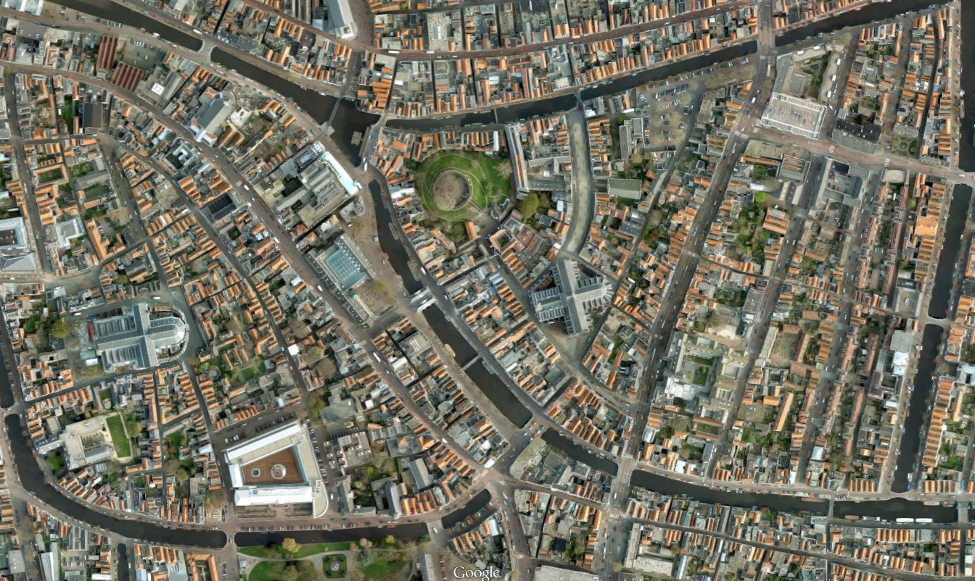
Leiden city centre – Screenshot from Google Maps
Notes:
* Using maps is common for many applications.
* Usually, some specific details are desired more, so others have to be filtered.
* Sattelite imagery quickly becomes too data-dense, we need a cartographic view.

Slide 3
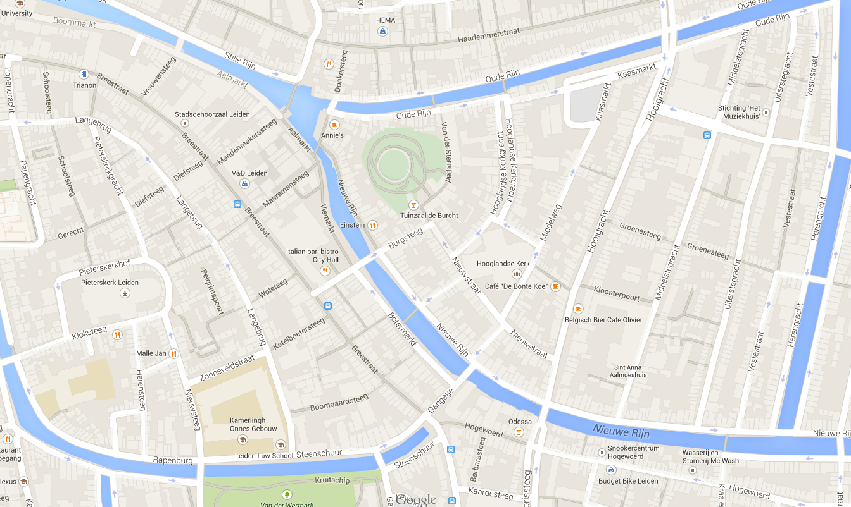
Leiden city centre – Screenshot from Google Maps
Notes:
Cartographic views can show some details and hide others.
They do introduce a problem that’s less visible in satellite maps: Many things pop in and out at once while zooming.

Slide 4
Notes:
Classical model
Multiple layers
No data inbetween
In practice, such as Google Maps, blending occurs to give the illusion of smooth transitions.
More data can be useful
In applications such as surveying, navigation
More layers is bad, no sure way to know how many is enough.

Slide 5
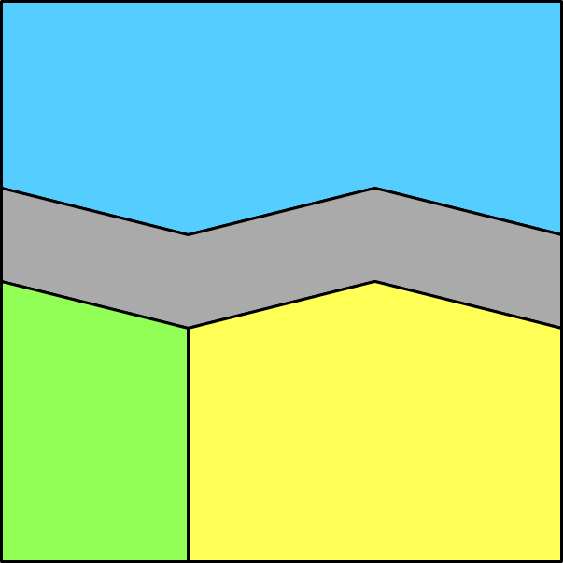
Introduction
Simple example
Water
Road
Forest
Farmland

Slide 6
Introduction

Slide 7
Introduction
Classical model
No data in between
Could be useful (surveying, navigation, etc.)
Simply adding more layers is impractical
Notes:
More layers is bad:
How many is enough.
Too much data.

Slide 8
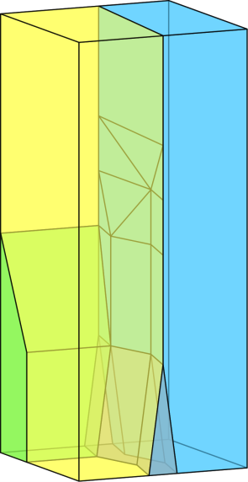
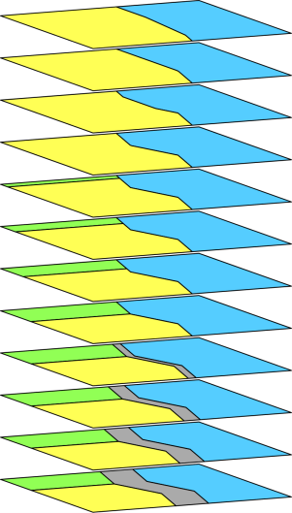
Introduction
Alternative: Space Scale Cube (SSC) model.
Notes:
Alternative: Space Scale Cube model
Has been in development at the TU Delft for some years
Does away with discrete layers
1 object, where layers are replaced by a 3rd axis
This makes it possible to precisely define where, for example roads become unimportant.

Slide 9
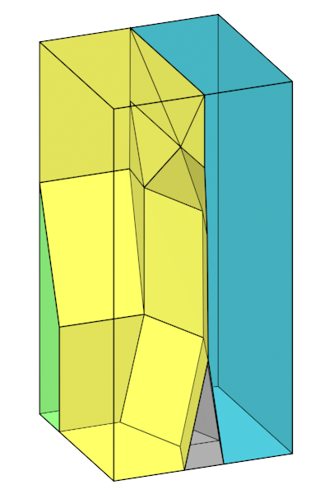
Introduction
Problem:
Model is smooth
No smooth intersecting method
Our contribution:
Real time intersecting
Shown in a prototype
Notes:
Efficient -> Low cost
Easy on the server and the client
Minimum amount of calculations
Fast -> Real time
Makes it practical for consumer devices (web browsers, smartphones)
SHOW VIDEO: scrolling with a horizontal plane.

Slide 10
Notes:
SHOW VIDEO: scrolling with a horizontal plane.

Slide 11
Notes:
SHOW VIDEO: Simple data

Slide 12
More Contributions
Smoothed coloring
Show less abrupt transitions in motion
Notes:
Coloring is a common function
Day colors / Night colors in car navigation.
More than just mapping, we add smoothness while zooming
In using the application, transitions seemed difficult to follow sometimes.

Slide 13
More Contributions
Notes:
SHOW VIDEO: normal transitions.

Slide 14
More Contributions
Notes:
SHOW VIDEO: smoothed transitions

Slide 15
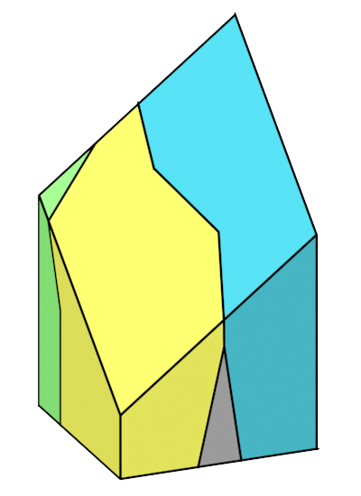
More Contributions
Non-horizontal intersections
Notes:
Non-horizontal
Allows for a view of high and low abstraction in the same image.
Can be used for:
Highlighting areas.

Slide 16
More Contributions
Notes:
VIDEO: Details in the center

Slide 17
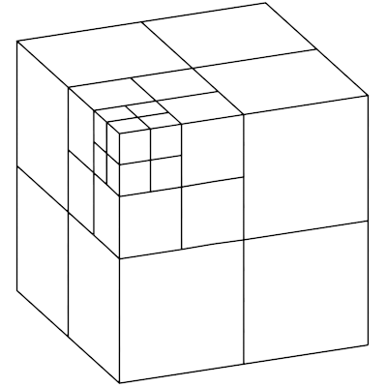
More Contributions
Subdivision structure
Needed for very big maps
Notes:
Because SSC is 3D, we need a structure that holds 3D chunks.

Slide 18
Overview
Intersection method
Core approach
Non-horizontal intersections
Smoothed coloring
Subdivision structure
Chunks
Visibility testing

Slide 19
Intersection method
Problem definition:
Choose a region to intersect
Display the intersection on the screen

Slide 20
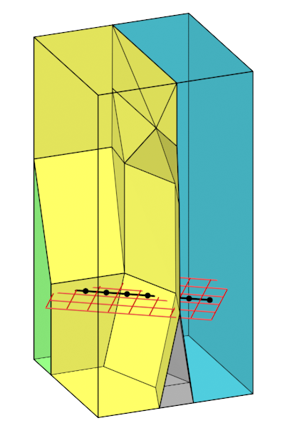
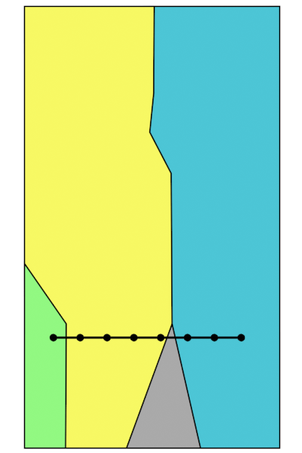
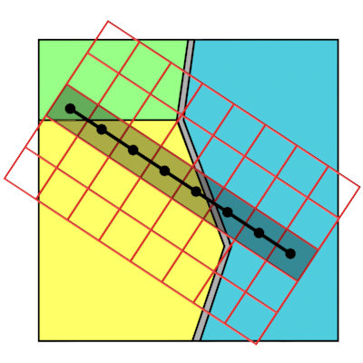
Intersection method
Displaying on the screen implies a pixel grid
Y
Z
Z
X
X
Y
X / Y
Notes:
The 8x5 grid shown here corresponds to the screen resoltion.
Of course, in practice a higher resolution is used.
To determine the colors of pixels, we have to test a point inside the pixel.
The black points indicate pixel centers.
I’m also highlighting a single row of pixels.
The right image shows the row from the side, in contrast to the top view of the left image.

Slide 21
Intersection method
Give each pixel a color
1 green (forest)
4 yellow (farmland)
3 blue (water)
How?
Notes:
How do we determine colors? Going over all pixels, and testing against all shapes is expensive.

Slide 22
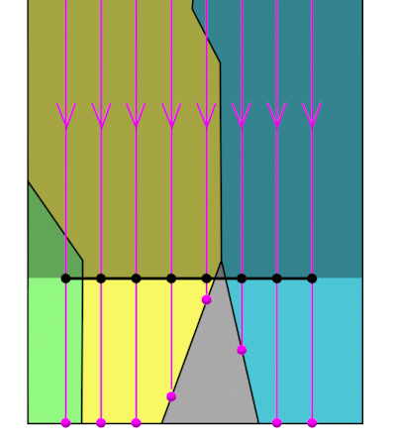
Intersection method
Solution:
Project the points downwards, ignoring the greyed area.
First hit boundary has the color we want.
Notes:
Boundaries may involve two objects, in which case we strictly choose the object above the intersection point.
The inside of the object is always the correct one, so grey is never chosen here.
This is actually correct even though the black line intersects the road, the resolution is simply not high enough.

Slide 23
Intersection method (Implementation)
All calculations can be made to only involve triangles and pixels
Works great with current hardware (graphics acceleration)

Slide 24
Intersection method (Implementation)
Graphics pipeline (simplified):
Triangles -> Fragments -> Pixels
Fragments differ from pixels
Also has Z (abstraction) data

Slide 25
Intersection method (Implementation)
Draw all objects as triangles
Discard all fragments above the raster Z-value
Sort remaining fragments, keep the highest.
Z
X / Y
Notes:
This >> the entire method

Slide 26
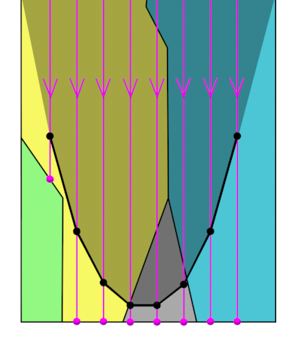
Non-horizontal intersections
Use a non-horizontal raster
Each pixel has its own Z-value

Slide 27
Non-horizontal intersections
Compare against a non constant Z-value
Only requirement:
prepare the Z-values in advance.

Slide 28
Non-horizontal intersections
Preparing Z-values
Any function of this form:
$$Z=f(x,y)$$
Cost depends on function
But usually cheap

Slide 29
Non-horizontal intersections
Notes:
SHOW VIDEO: Shepards interpolation

Slide 30
Smoothed coloring
Abrupt changes do not look very good.
Notes:
SHOW VIDEO: comparison of hard and smooth coloring (Same as in the introduction).

Slide 31
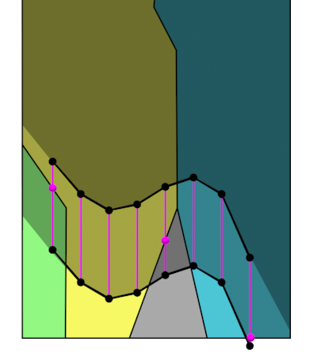
Smoothed coloring
To smooth color transitions:
Find the next color, if any
Blend the two colors

Slide 32
Smoothed coloring (Implementation)
Find nearby boundaries (within a maximum distance)
Both colors are on that boundary.
Notes:
When in motion, you would want to see some fading
Direct changes are

Slide 33
Smoothed coloring (Implementation)
Blend the colors with a distance factor
$$f_{blend}=\frac{d_{boundary}}{d_{maximum}}$$
$${color}_{final}=f_{blend} ∗{color}_{A}+{\left(1 −f_{blend}\right)∗color}_{B}$$
Notes:
When in motion, you would want to see some fading
Direct changes are

Slide 34
Smoothed coloring
Notes:
When in motion, you would want to see some fading
Direct changes are

Slide 35
Overview
Intersection method
Core approach
Non-horizontal intersections
Smoothed coloring
Subdivision structure
Chunks
Visibility testing

Slide 36
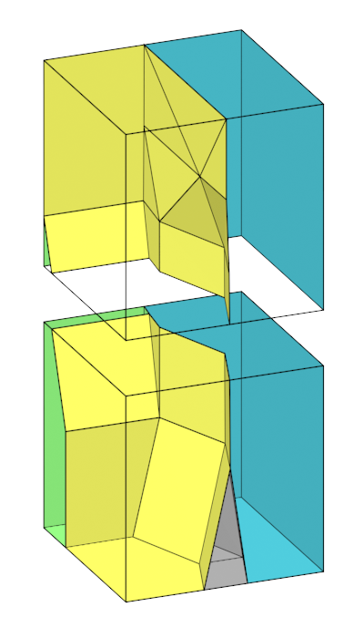
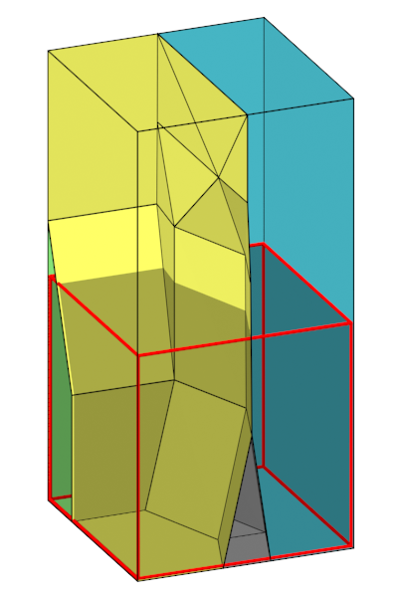
Chunks
Notes:
Imagine our data becomes so large, we can’t show it in one part.
We then need a way to subdivide the data into smaller chunks.
Many chunks together again form the same object.

Slide 37
Chunks
Need the same properties as the SSC
Partition of space:
Closed objects
Tightly fitting
Notes:
Each chunk will need to give a good intersection result, regardless of whether other chunks are also present in the same view.
We need chunks to have the same properties as the SSC. The intersection method depends on it.

Slide 38
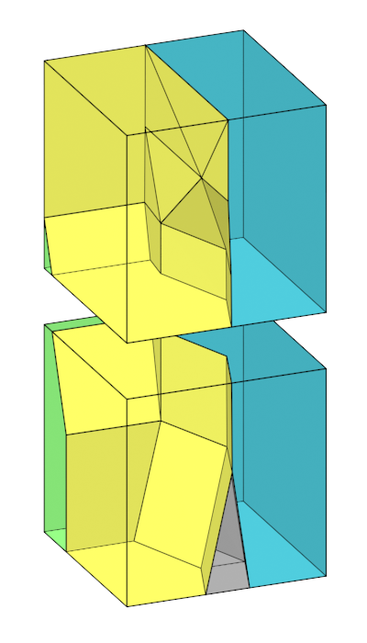
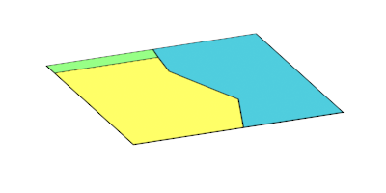
Chunk construction
Add extra polygons to fill up gaps
Notes:
The extra polygons added must fit precisely.
That’s it for chunks!

Slide 39
Subdivision structure
Chunks need to be part of a structure
Placement in relation to other chunks, and the raster

Slide 40
Subdivision structure
The structure needs to:
Make a distinction between dense and sparse regions
Quickly find visible chunks

Slide 41
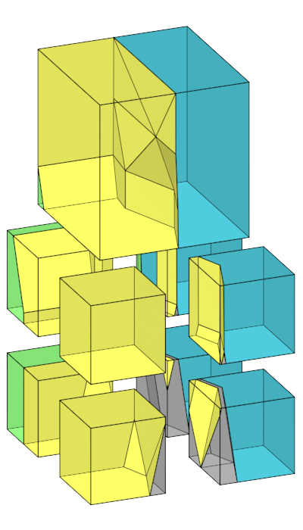
Subdivision structure
Dense vs sparse regions
Some areas will have more geometry than others
Notes:
Necessary with the SSC
Bottom parts will almost always have more geometry than top parts.
Also topographically: oceans will have less data than most land regions.
Denser parts will need to be split up more.

Slide 42
Octree structure
Notes:
Octrees support the storage of such subdivisions in a single structure.
Octrees also allow for a lot of simplifications, one of which is querying, which we use for visibility testing...

Slide 43
Octree structure
Finding the chunks that intersect the raster
We only need these chunks
Find them with ‘visibility testing’
Notes:
Visibility testing means we use the raster again, but look for chunks

Slide 44
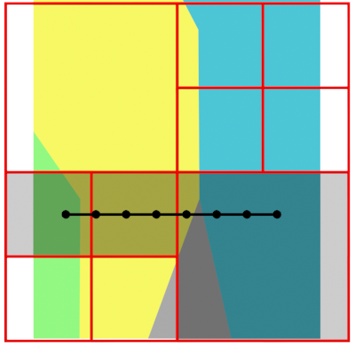
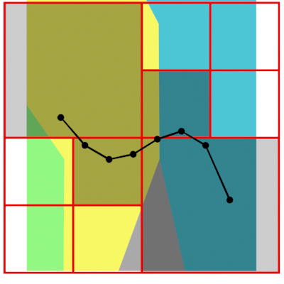
Octree structure
Two cases
Planar (easy) Non-planar(difficult)

Slide 45
Octree structure
Why difficult?
Octrees queries work best with primitives (planes, boxes)
We have a variable surface

Slide 46
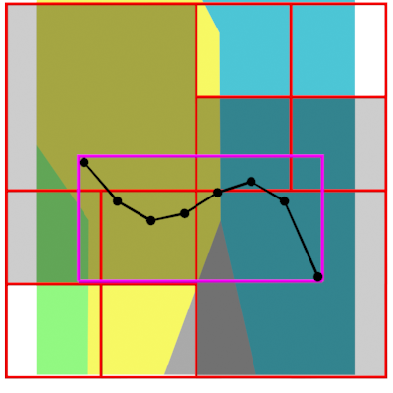
Octree structure
Solution
Start with a box query
Now, check each chunk from the box query

Slide 47
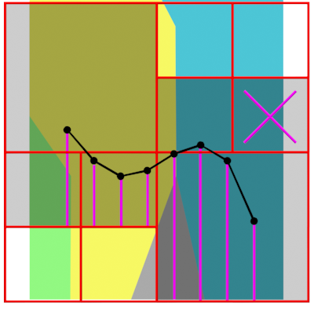
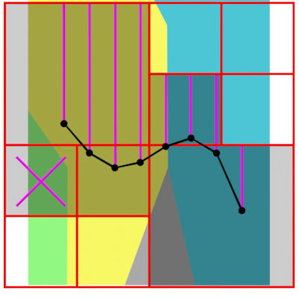
Octree structure
Project on chunk boxes
Project pixels down
Remove invisible chunks
Project pixels up
Remove invisible chunks

Slide 48
Improvement points
Server-client architecture
More efficient visibility testing

Slide 49
Conclusion
Real time SSC intersections
Non-horizontal
Smoothed colors
Subdivision structure
Important steps to make the SSC model more practical.

